Slide 1



CHM 103: Organic Chemistry I
Presented by:
Assoc Prof Okoli BJ MRSC, MACS
Department of Chemical Science,
Faculty of Science & Technology
Bingham University
The University with the difference
Bingham University

Slide 2
Alkanes: General formula, nomenclature, natural sources synthesis, uses, physical and chemical properties. Alkenes: General formula and nomenclature. Natural sources and synthesis. Physical and chemical properties. Relevant functional group transformations. Brief mention of dienes and cycloalkenes. Alkynes: General formula and nomenclature. Synthesis and reactions of alkyne, uses. Alkyl halides: General formula and nomenclature. Synthesis and reactions. Brief mention of polyhalides and their uses in the chemical industry. Alkanols: General formula and nomenclature. Natural sources and synthesis. Physical and chemical properties and uses. Brief mention of polyhydric alcohols. Carbonyl compounds: Alkanals and Alkanones. General formula, nomenclature and chemical properties. Carboxylic acids. Brief introduction to bio-molecules: carbohydrates and proteins. Synthetic polymers.
Course Synopsis
Bingham University
The University with the difference
Bingham University

Slide 3

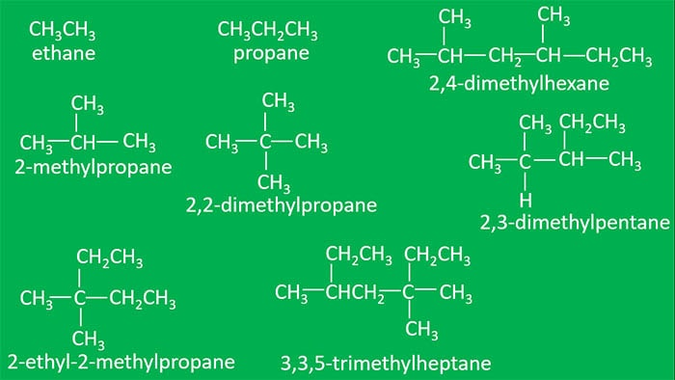
ALKANES
Alkanes are also introduced as Paraffin compounds. Most fuels such as petrol, diesel, LP gas, kerosene and more contains alkanes.
Physical properties of Alkanes
saturated hydrocarbons
Common formula of alkane is C₂H_{2n+2} ; n = 1,2,3,4...
Alkanes IUPAC naming | nomenclature
Alkanes IUPAC naming is simple.
longest carbon chain
Substituents
Some examples are noted here.
Bingham University

Slide 4

Preparation of Alkane
Alkanes are prepared from different organic compounds as follows:
Catalytic hydrogenation
Wurtz reaction
Reduction of alkyl halides
1. Catalytic hydrogenation: Alkenes and Alkynes can be converted into alkanes at high temperature and catalyst such Raney Nickle (Ni), Platinum (Pt), or Palladium (Pd) are used as catalysts
(i)
(ii)
(iii)
Bingham University

Slide 5
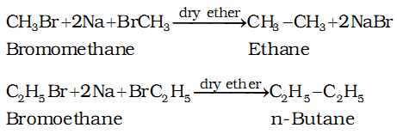
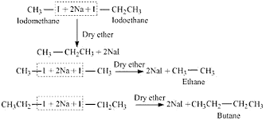
2. Wurtz reaction: The Wurtz Coupling produces the simple dimer derived from two equivalents of alkyl halide. Then a symmetrical alkane containing twice the number of carbon atoms of alkyl halide is obtained
Bingham University

Slide 6
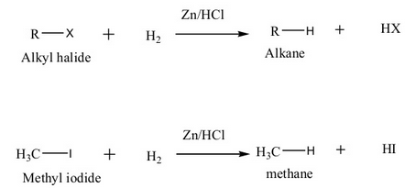
3. Reduction of alkyl halides
Alkyl halides on reduction with nascent hydrogen form alkanes. The nascent hydrogen may be obtained by any one of the following;
Zn + HCI,
Zn + CH₃COOH,
Zn-Cu couple in ethanol,
Red P + HI, and
Al-Hg + ethanol.
H₂/Pd or LiAIH₄ or by H₂/Ni.
Bingham University

